Slide 1

Progress Showcase A
Name: Andreea Maria Chis
Course: Front-end development

Slide 2
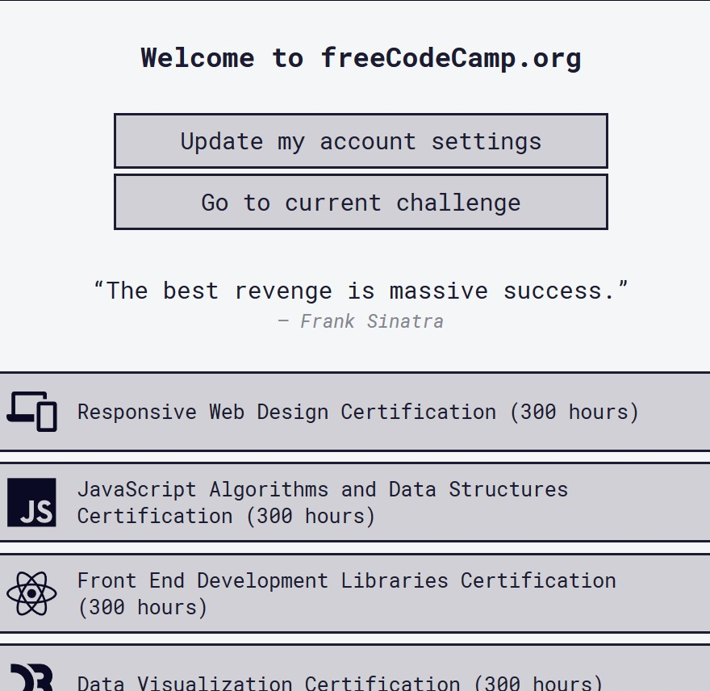
Intro
For the first progress showcase I have started the 30-Day JavaScript challenge
I have started doing a portofolio website for a fictional photographer
I also learned HTML & CSS & JAVASCRIPT from freeCodeCamp

Slide 3
Reflection
I learned and exercised more with HTML and CSS than JavaScript but from now I will focus more and more on the programming language by doing the challenge, watching tutorials, reading the book “JAVASCRIPT & JQUERY interactive front-end web development”. I will also create a second website that consists more of Javascript to show my progress in the language.

Slide 4
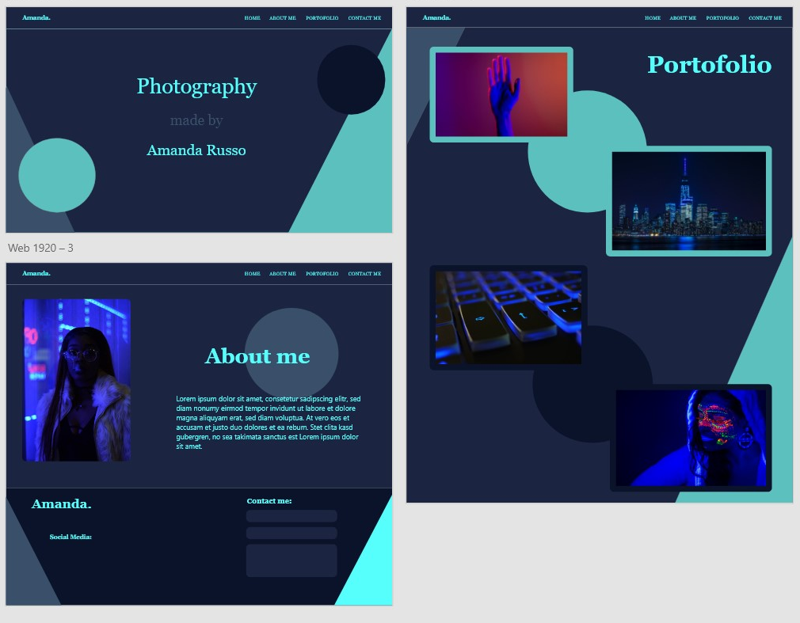
First website: Photographer portfolio wireframe

Slide 5
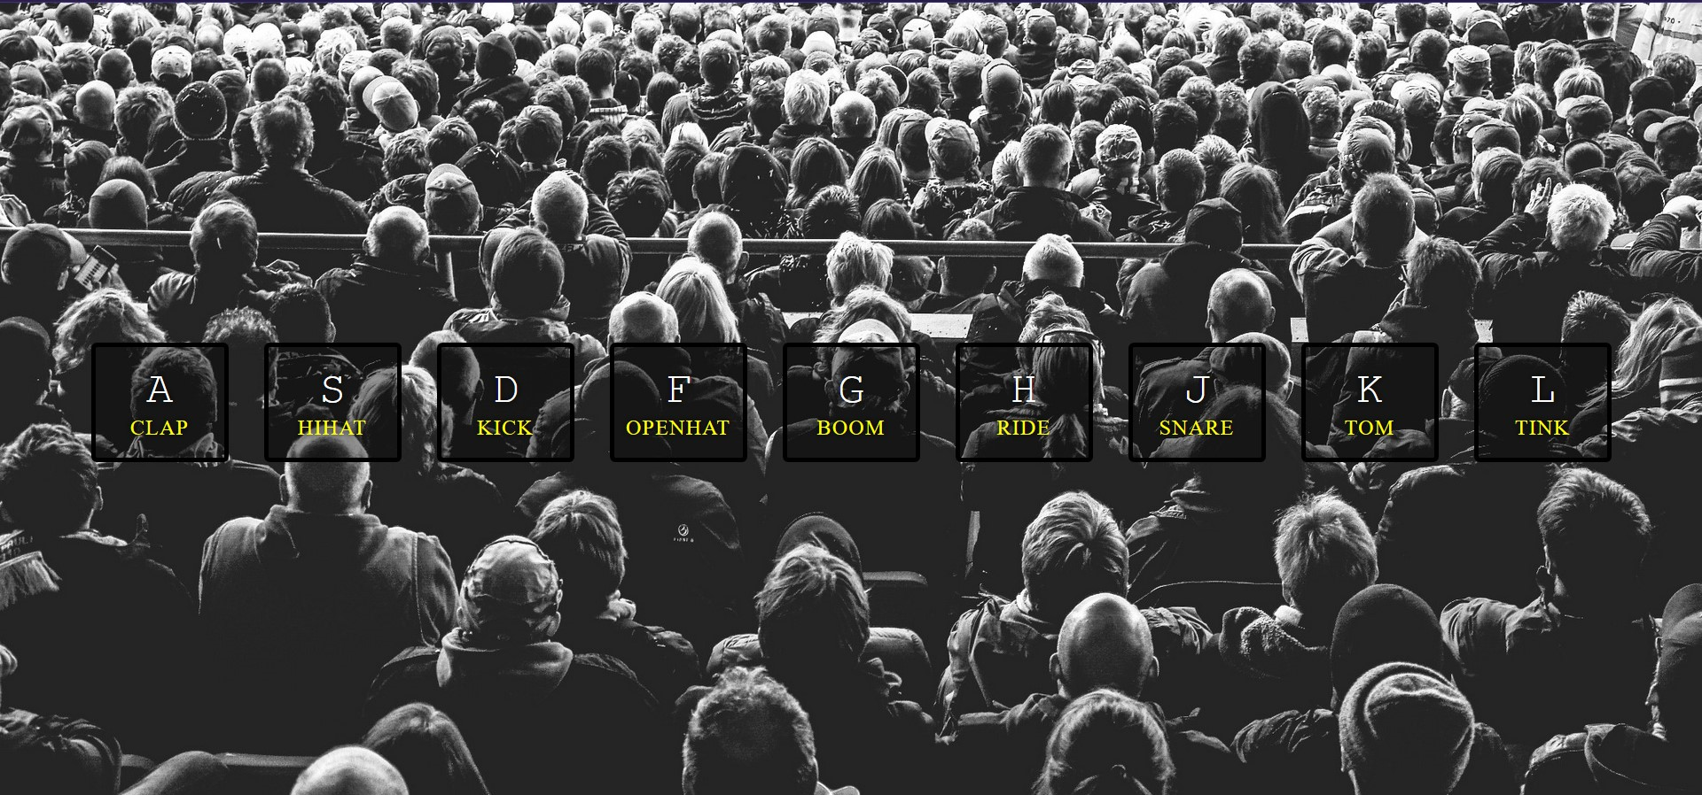

30-DAY JavaScriptChallange

